Slide 1
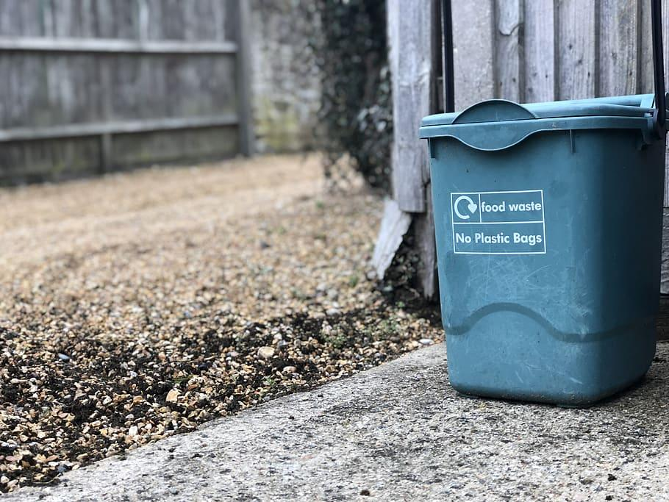
SMART DUSTBIN
ME1050
GROUP 5
Vilan Jayawardene - EN21466830
Vinal Gamage - EN21481130
Kasuni Dissanayake -EN21485640
Dulanthi Perera - EN21482120
Thinuri Isaka - EN21492716

Slide 2


Introduction
There is a threat for cleaners to touch the overflowing trash bags in this pandemic situation
They should use their hands to tie the knot in trash bags
When the dustbin is full, the users still throw the garbage into the bin
Overflowing trash bins are leading to unhygienic conditions and bad smell arises
The use of existing systems for trash bins results in time wasting and money spending

Slide 3

How did we collect needs?
Research articles
Television documentaries
Magazine articles
Government publications
Survey from minor staff(hospitals)
Feedbacks(public survey)

Slide 4
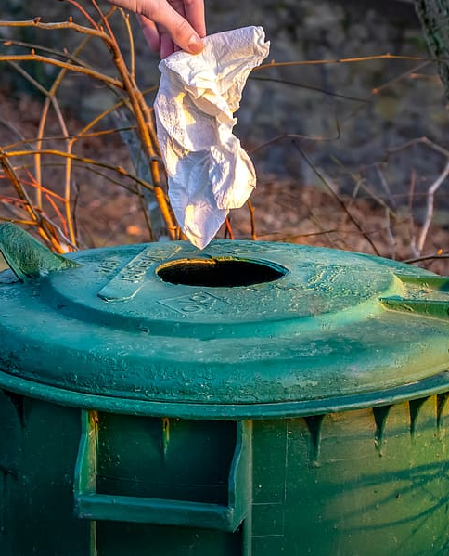

Objectives, Constraints and Limitations
Objective | Constraints | Limitations
Time saving | Low quality sensor | Low accuracy
Automation | Government rules and regulations | Low budget Unable to find parts
Properly managing waste | Government tax | Unable to find parts
Reduction of bad odor | Low quality rubber seals | Rubber seal damaging
Spill level controlling | Negligence | Cannot be placed everywhere
Easy to service | Lack of skill labors | Lack of technical knowledge
Easy to use | Low quality low capacity in the battery | Charging battery frequently The polythene bag may tear
Easy to assemble/ replace | Relatively expensive | Unable to find parts
Marketability | Competitors | Shrinking the customer base
Automated sealing | Low quality of a zip tie | Zip tie can break

Slide 5





Requirements and Specification
Categorized Requirements
Market Requirement
Functional Requirement
Technical Requirement
Performance Requirement
Quality Requirement
Software Requirement
Hardware Requirement

Slide 6
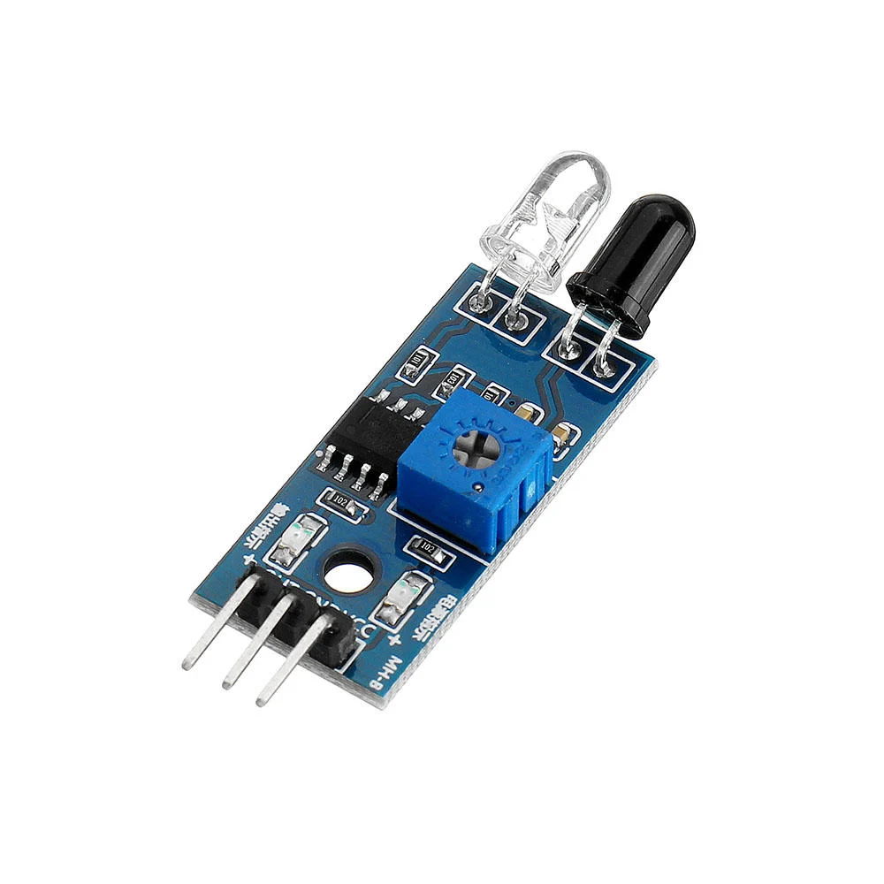

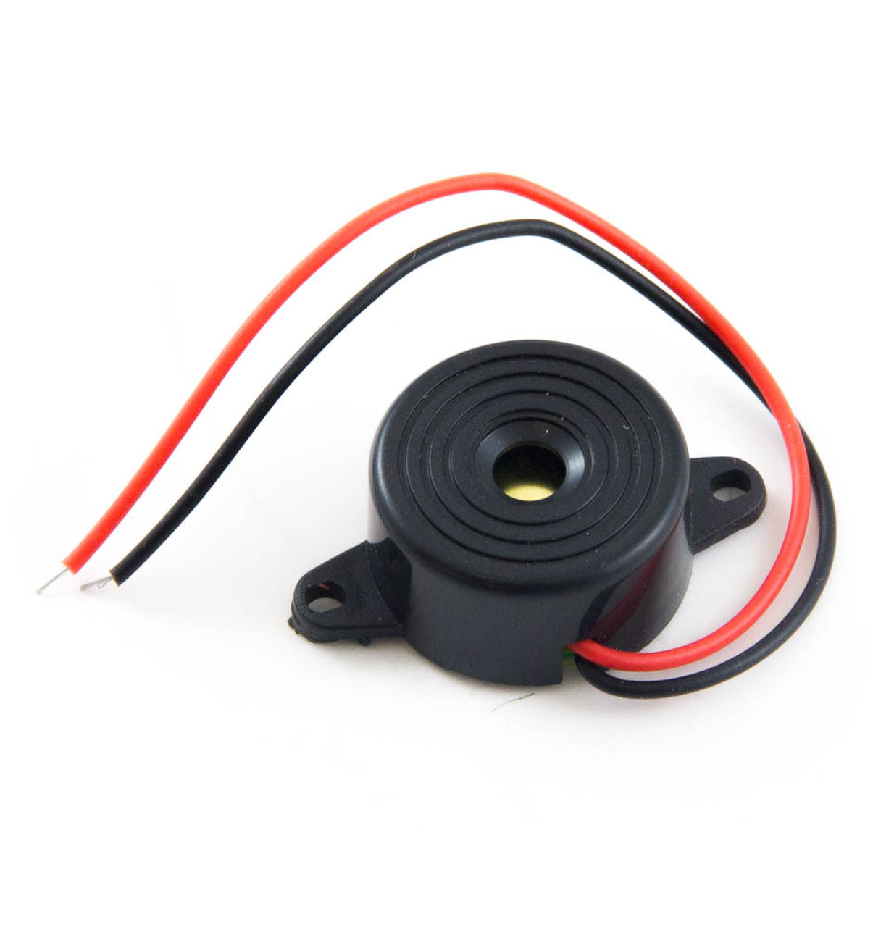
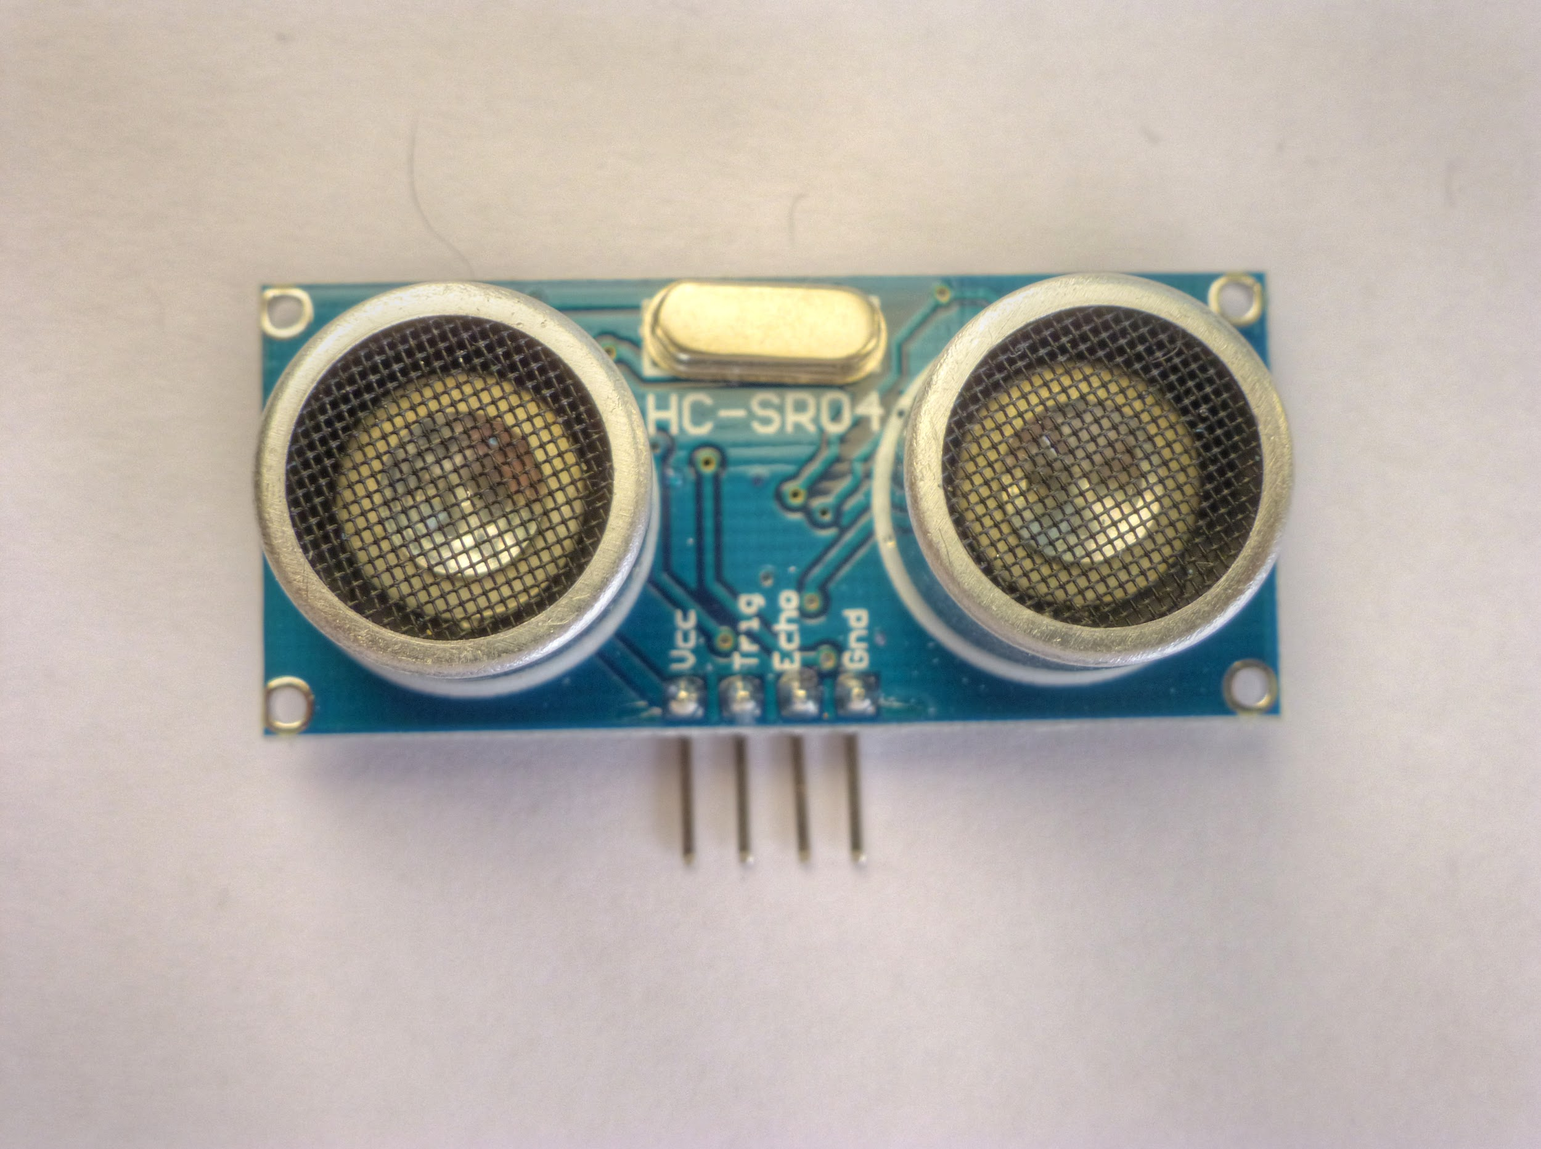
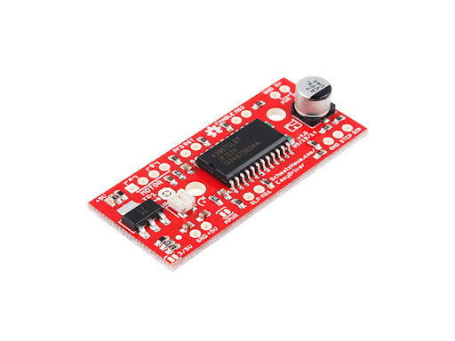

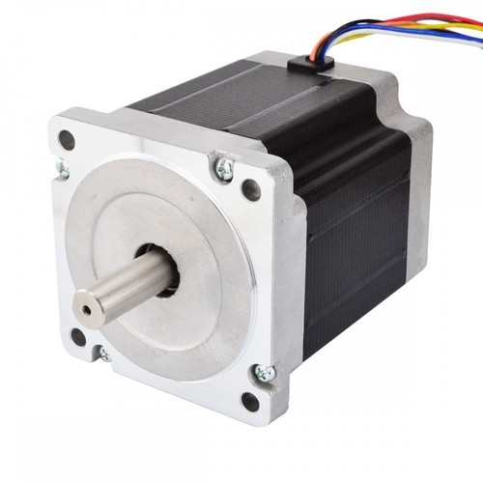
Specification List
Detecting a person
• Infrared obstacle avoidance sensor module adjustable (YL – 63)
■ can detects the object between 2 – 30 cm
■ Detection angle 35 °
Measuring the trash level
• Ultrasonic sensor HY -SRF05
■ most widely used range is 40 to 70 kHz
Lid motor mechanism
• Servo motor SG90
■ servo motor that can rotate approximately 180°
Motor mechanism of sealing the trash bag
• NEMA 17 17HS4023 stepper motor
■ Step Angle(degrees): 1.8
Operating of microcontroller
• Arduino Uno R3 AT mega 328p
■ Operating voltage:2.7V to 5.5V for ATmega328P

Slide 7
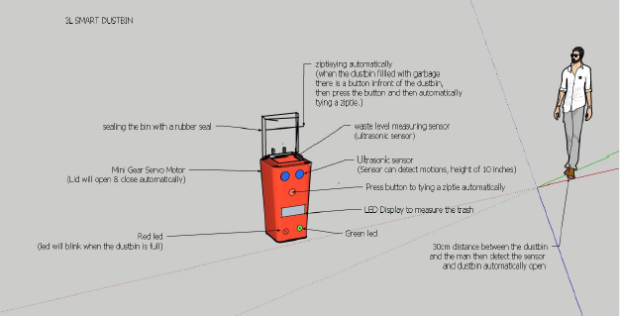
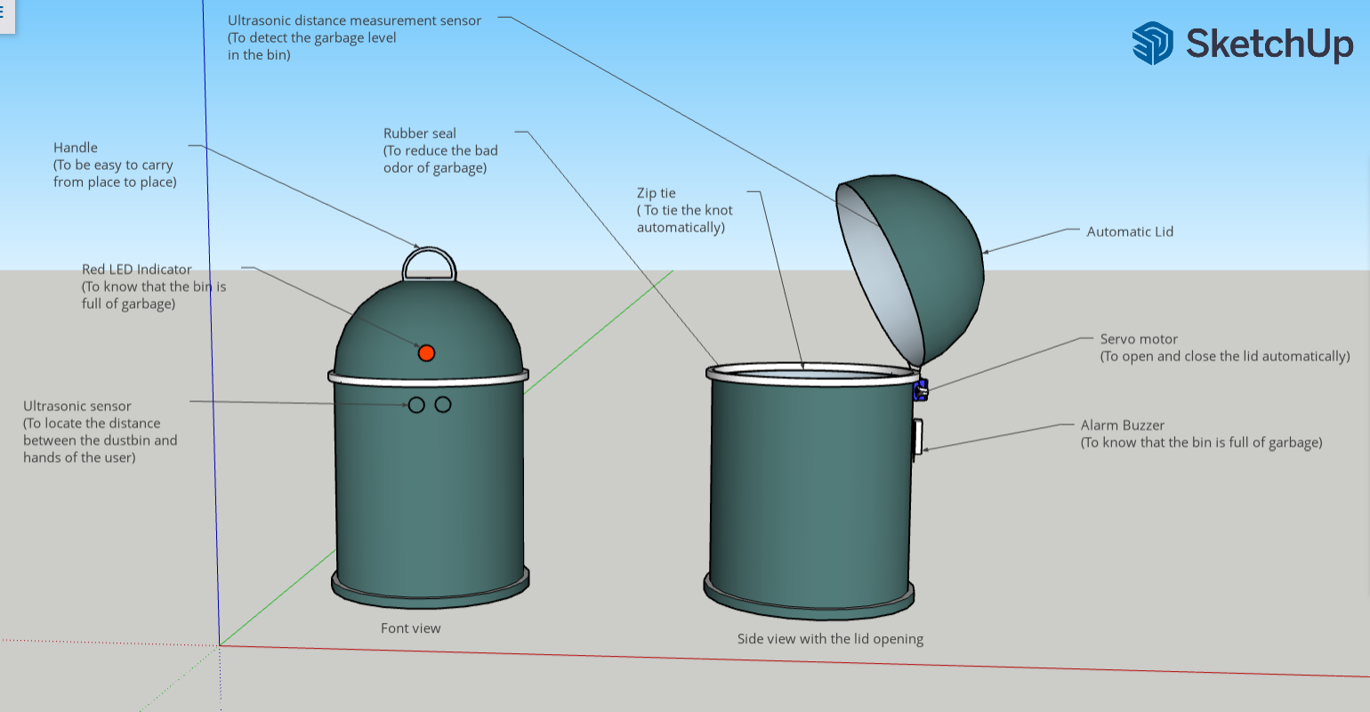
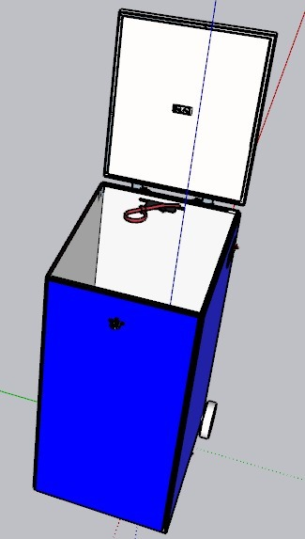
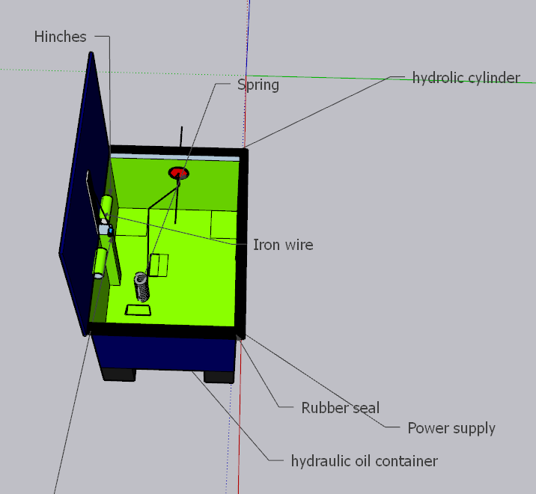
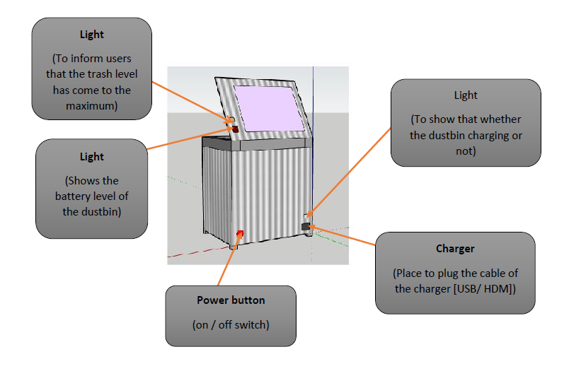
Conceptual Designs
Figure 1
Figure 4
Figure 3
Figure 5
Figure 2

Slide 8
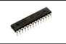
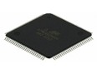
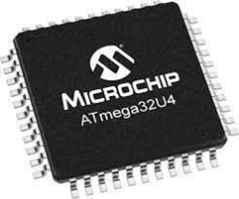
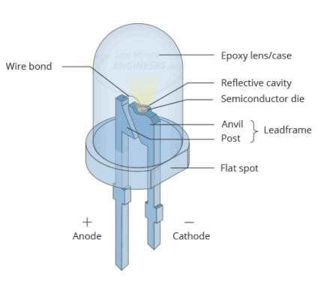
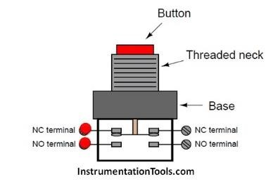
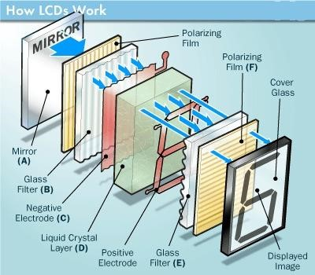
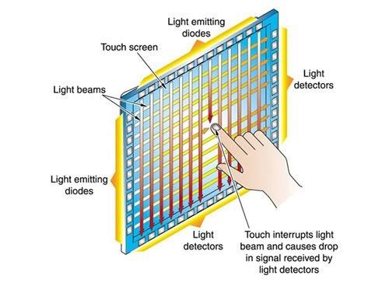
Alternatives with Physical Principle, Working Principle and Abstract Embodiment
Sub function | Alternative | Physical principle | Working principle | Abstract embodiment
Operating of microcontroller | Arduino UNO Board | Digital signal conversion with C+ programming |  | ATmega328
 | Arduino Mega |  |  | ATmega2560
 | Arduino Leonardo |  |  | ATmega32u4
Displaying data and controlling device | LED – Button System | Electro-luminance |  | 3 LEDs with 2 buttons
 | LCD Display | An electrical current is applying to the liquid crystal molecules, the molecule tends to untwist |  | Liquid crystal
 | Touch screen | The body electrical induction |  | Infrared touch screen

Slide 9
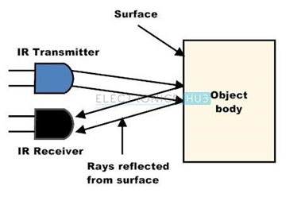
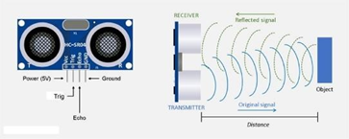
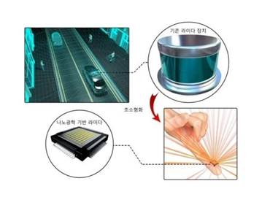
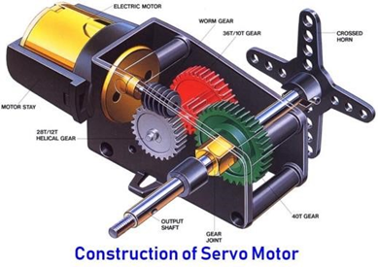
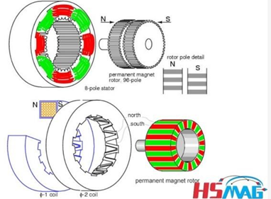
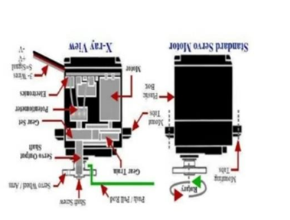
Detecting a person | Infrared sensor | Reflected light waves |  | IR sensor
 | Ultrasonic sensor | Emission and reflection high frequency ultrasonic waves | . | Ultrasonic sensor
 | LiDAR sensor | Emission and reflection of light waves from a laser |  | LiDAR sensor
Lid motor mechanism | Servo motor | PWM principle |  | SG90, MG995, MG90
 | Stepper motor | By energizing one or more of the stator phases, a magnetic field is generated by the current flowing in the coil and the rotor aligns with this field |  | Permanent magnet stepper
 | AC standard servo motor | PWM principle (Pulse Width Modulation) |  | Positional rotation AC servo motor

Slide 10
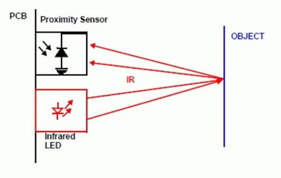

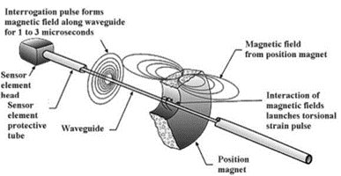
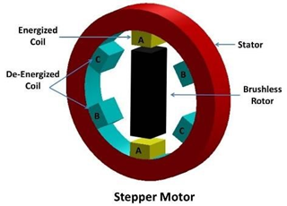
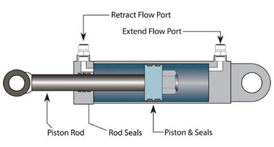

Measuring the trash level | Ultrasonic sensor | Emission and reflection high frequency ultrasonic waves |  | Ultrasonic proximity sensor
 | Infrared sensor | Reflected light waves |  | Active infrared sensor
 | Position sensor | Light is transmitted from an emitter and sent over to a receiver at the other end of the sensor |  | Linear position sensor
Motor mechanism of sealing the trash bag | Stepper motor | By energizing one or more of the stator phases, a magnetic field is generated by the current flowing in the coil and the rotor aligns with this field |  | Permanent magnet stepper
 | Hydraulic system | Pascal law |  | Hydraulic cylinder
 | Servo motor | PWM principle |  | DC servo motor

Slide 11
Alternative comparison
Sub functions | Alternatives
 | 1 | 2 | 3
Operating of microcontroller | Arduino UNO board | Arduino Mega | Arduino Leonardo
Displaying data and controlling device | LED – Button system | LCD Display | Touch screen
Detecting a person | IR sensor | Ultrasonic sensor | LiDAR sensor
Lid motor mechanism | Servo motor | Stepper motor | AC standard servo motor
Measuring the trash level | Ultrasonic sensor | Infrared sensor | Position sensor
Motor mechanism of sealing the trash bag | Stepper motor | Hydraulic system | Servo motor

Slide 12

Proposed Testing Mechanism
Durability of rubber- Rubber is tested various tension, compression, and adhesion tests.
Arduino circuit and easy drive- Simulation is carried out using the Proteus software before attaching it to the dustbin, to test the circuit accuracy.
Sensors- Sensors are tested in different in environmental conditions, indoors and outdoors
Stepper and servo motor-Check to make sure the DC motor's rotor can turn with no impediments
Power consumption- Testing is carried out by considering the power consumption of each components in their highest and lowest voltage requirement.
Zip tie- It is tested by applying a force to determine its breaking point.

Slide 13


Item Category | Items | Cost (LKR)
For detecting a person and opening of the lid | IR Sensor, Servo Motor | 790.00
Detect garbage level and sealing trash bag | Zip tie, Ultrasonic Sensor, Stepper Motor, Easy Driver, Gear Rods | 1949.00
Charging device | Battery, SMPS Charger | 2290.00
Other components | Garbage Bin, LEDs, Push Button Micro Switch, Jumper Wire, Rubber Seal, Passive Buzzer, Arduino UNO Board | 8995.50
Total Cost |  | 14,024.50

Slide 14

Individual Contribution
Group Members | Contribution
Vilan Jayawardene | Made the final design (product) Contributed to both final report and final presentation Actively participate in doing all past assignments Made the final video
Vinal Gamage | Actively participate in doing all past assignments Contributed when making the final design Contributed to both final report and final presentation Helped Vilan to make the final video
Kasuni Dissanayake | Gave a good contribution in every week when doing the past assignments Done a lot in final presentation Contributed when making final report Gave the necessary ideas and helped in making the video
Thinuri Isaka | Actively participate in doing all past assignments Contributed to make final report Helped Kasuni when making the final presentation Gave the necessary ideas and helped in making the video
Dulanthi Perera | Gave a good contribution in every week when doing the past assignments Contributed to make final report Helped Kasuni when making the final presentation Gave the necessary ideas and helped in making the video

Slide 15


Project Learning Outcomes
Learning to use some new software
Ex:- SketchUp, fusion 360, Autodesk Maya,
Premier Pro, Auto Cad
Learning about Harvard Referencing
Working according to a Rubric
Doing Self Researching
Improving Presentation Skills
Working on time
Working as a Team

